Slide 1
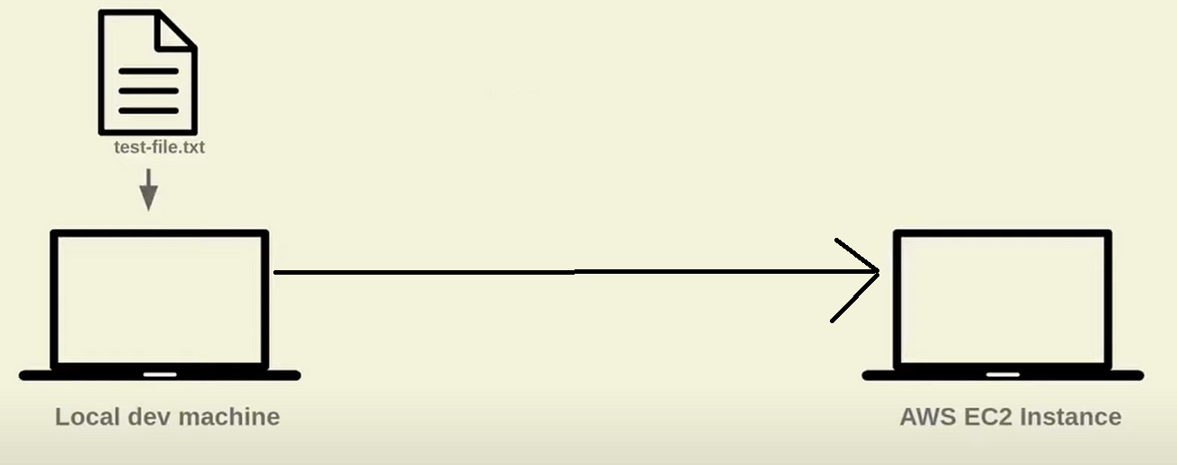

Slide 2
Local provisioner
Using a local provisioner in Terraform allows you to execute scripts or commands on the machine where Terraform is running. This can be useful for tasks like configuring the VM after creation or running post-provisioning steps.

Slide 3
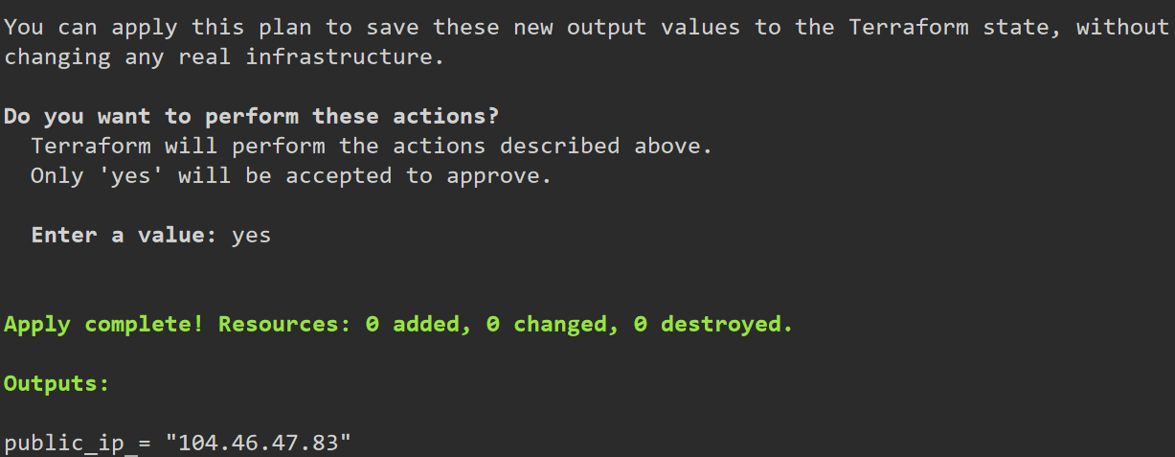

Slide 4
Remote provisioner
Using a remote provisioner in Terraform allows you to execute scripts or commands directly on the newly created VM. This can be done via SSH for Linux VMs or WinRM for Windows VMs. Below is a guide on how to set up a remote provisioner with an Azure Linux VM and output its public IP address.

Slide 5
Summary
In local provisioning we run command just for informative things like- a) Checking in server is up, b) getting IP address.
In remote provisioning, we install software on remote servers.

Slide 6
Links
Remote Provisioner: https://developer.hashicorp.com/terraform/language/resources/provisioners/remote-exec
Local Provisioner:
https://developer.hashicorp.com/terraform/language/resources/provisioners/local-exec

